Slide 2
Mechanical Engineering Projects and Curriculum for FRC Build Success
A case study on highlights, lessons learned, and takeaways for developing a robotics class
Team 7419: T.E.C.H. Support
The Quarry Lane School, Dublin, CA

Slide 3
Agenda
Introduction
Training Structure
RIS System
Mechanical Curriculum
Build Season Planning
Workshops
Projects
Other Training Materials
Questions

Slide 4
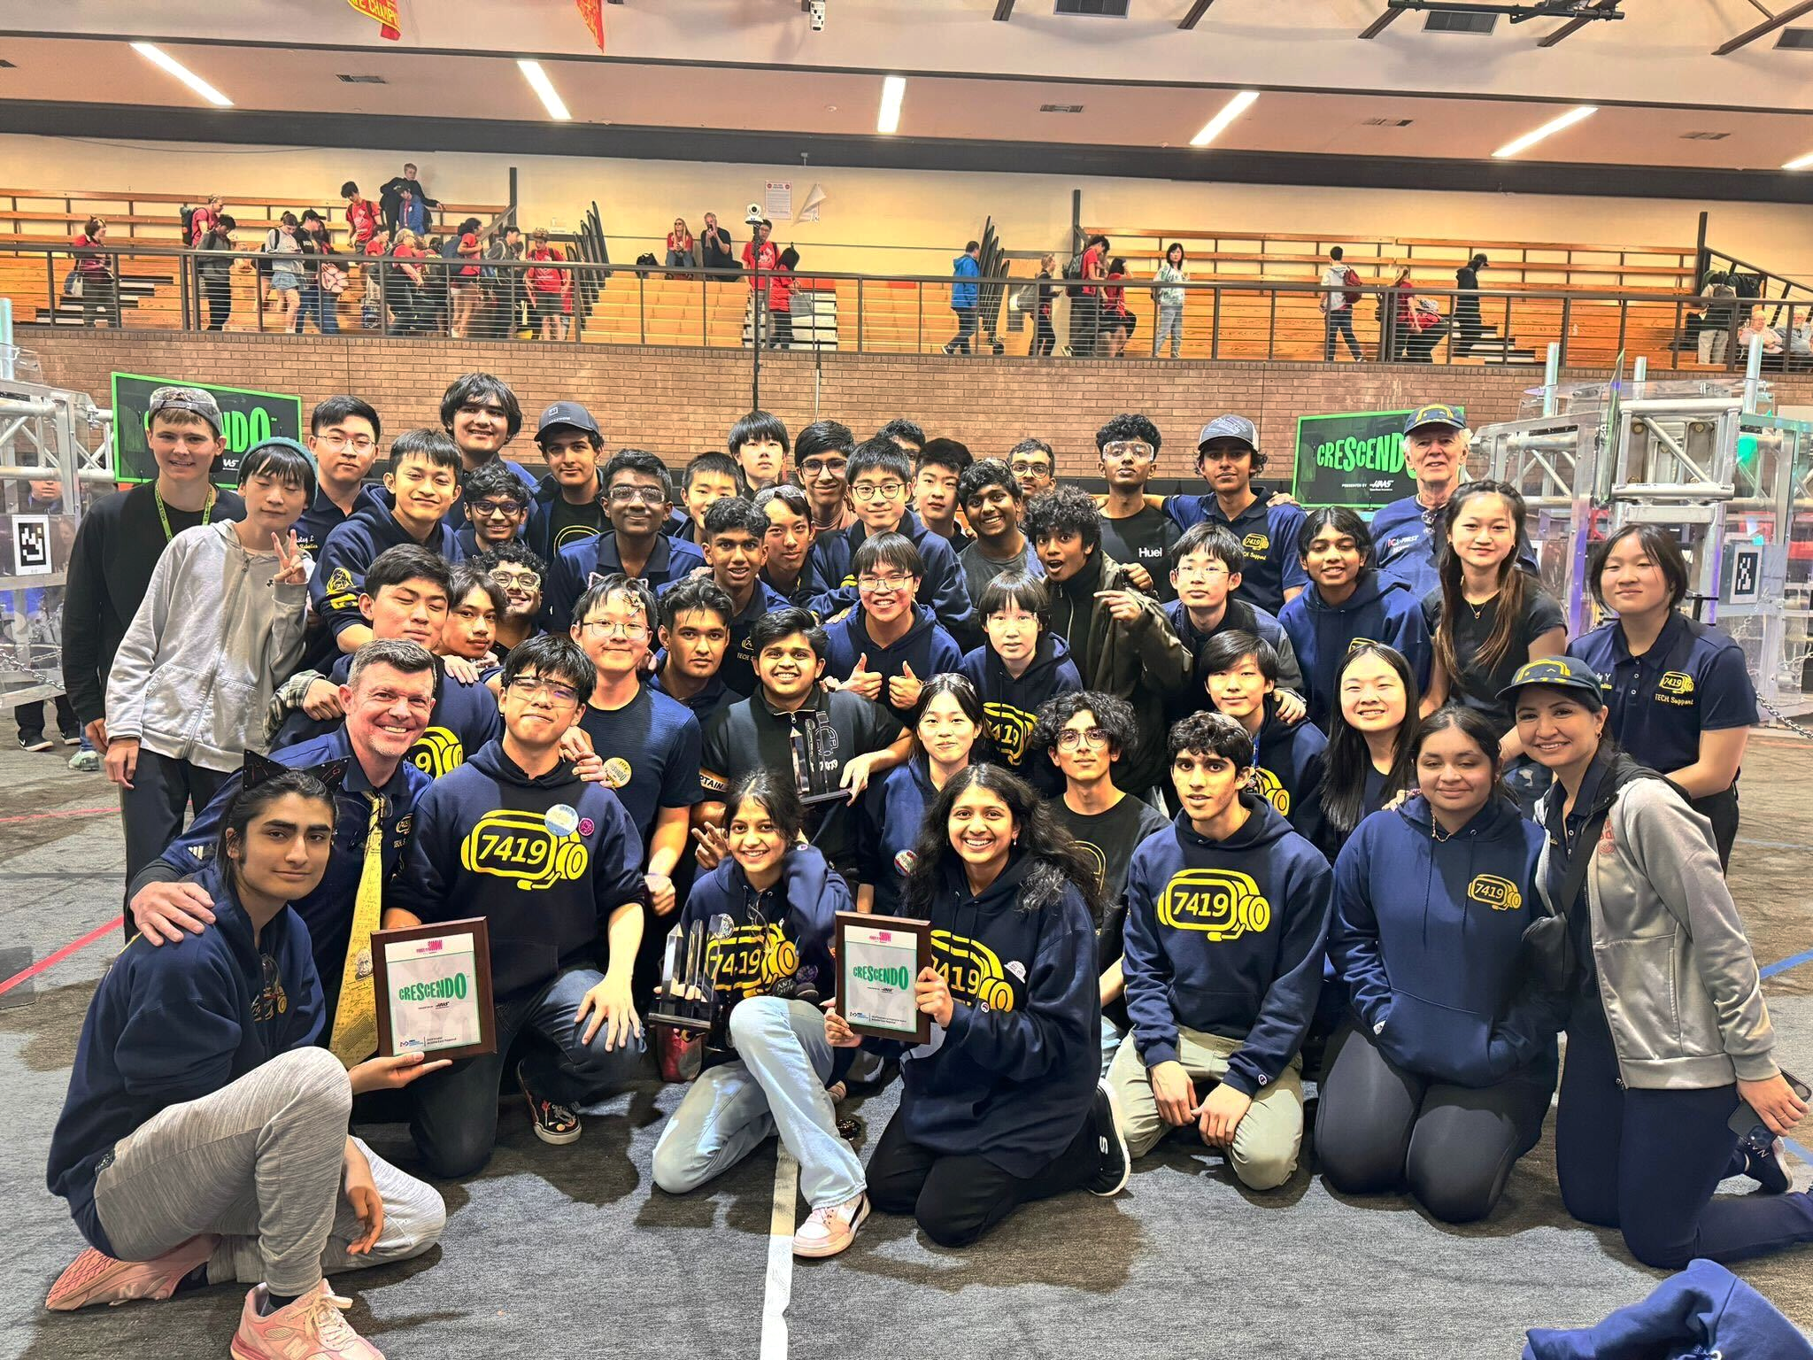
Introduction
We are a student-led team based in Dublin, California. Our rookie year was 2019.

Slide 5
Importance of Training Structure
Influx of first year members (Upwards of 60 a year)
Challenges:
Introductory training
Task distribution
Sustainable team culture
Incoming members must be sufficiently experienced in their respective department before build
Multi-faceted curriculum to engage members
Off-season experiences
Building a swerve Everybot
Offseason Competitions
Notes:
case study

Slide 6
Robotics Independent Study System
When done right:
“Soft landing” into FRC
Effective use of time and resources
Easily train students into highly skilled positions
Common pitfalls:
Students get out what they put in
Lack intrinsic motivation
High retention; low yield
Notes:
thanks. slide is good.

Slide 7
Mechanical Curriculum
The general curriculum is a day-by-day curriculum that is taught to new members
Developed by mechanical leadership over the summer
Mainly designed to introduce 1st-year students to the mechanical department
Gain exposure to all areas (Fabrication, Design, Assembly)
For ex: In week 1, students learned about basic hand tools, power tools, and shop machines.
Discover specialization areas
Notes:
Dev
https://docs.google.com/document/d/1-G2g6hnL6k9XNqYzyTgpXurvR2cqqxyJSdf6Gp3h3dQ/edit#heading=h.ot35kko7w8ws

Slide 8
Workshops
Highly advised for students to attend
Helps motivate interested students to learn more
Introduction to specializations
Workshops cover a range of topics, audiences, and formats
Introductory, like intro to CAD
Advanced, like Electrical, CNC, Mechanism Design
Addresses shortfalls of RIS system
Unbalanced periods due to schedule conflicts
Smaller, more focused sessions
More time and resources
Notes:
Sar

Slide 9
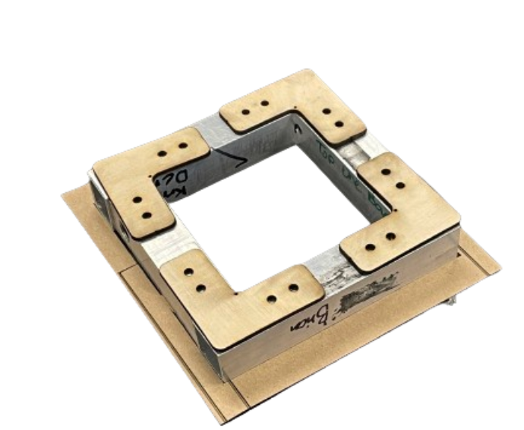
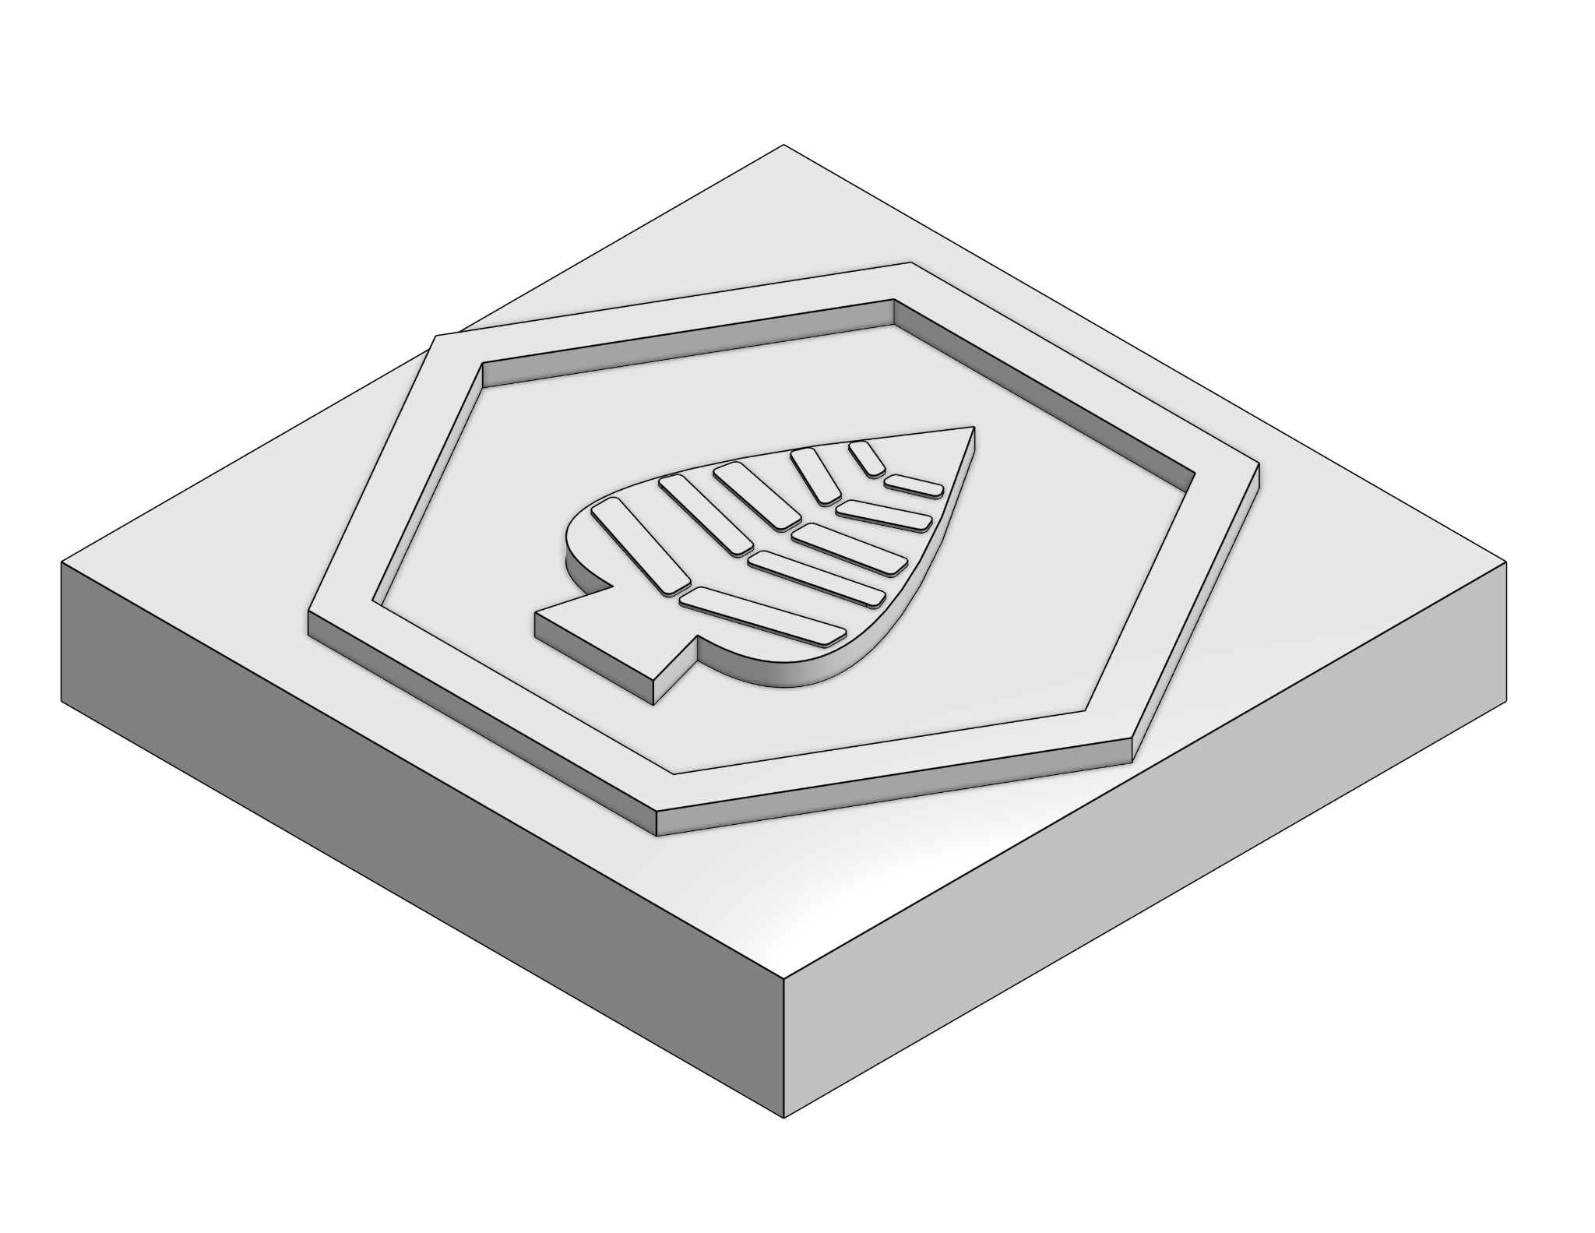
Projects
Off-season projects allow for and standardized feedback
Square Project - laser cutter, drill press, basic CAD
Stamp Project - CAD, 3D Printing, Tolerances
Electrical Board - FRC control system and wiring best practices
Notes:
Michelle

Slide 10
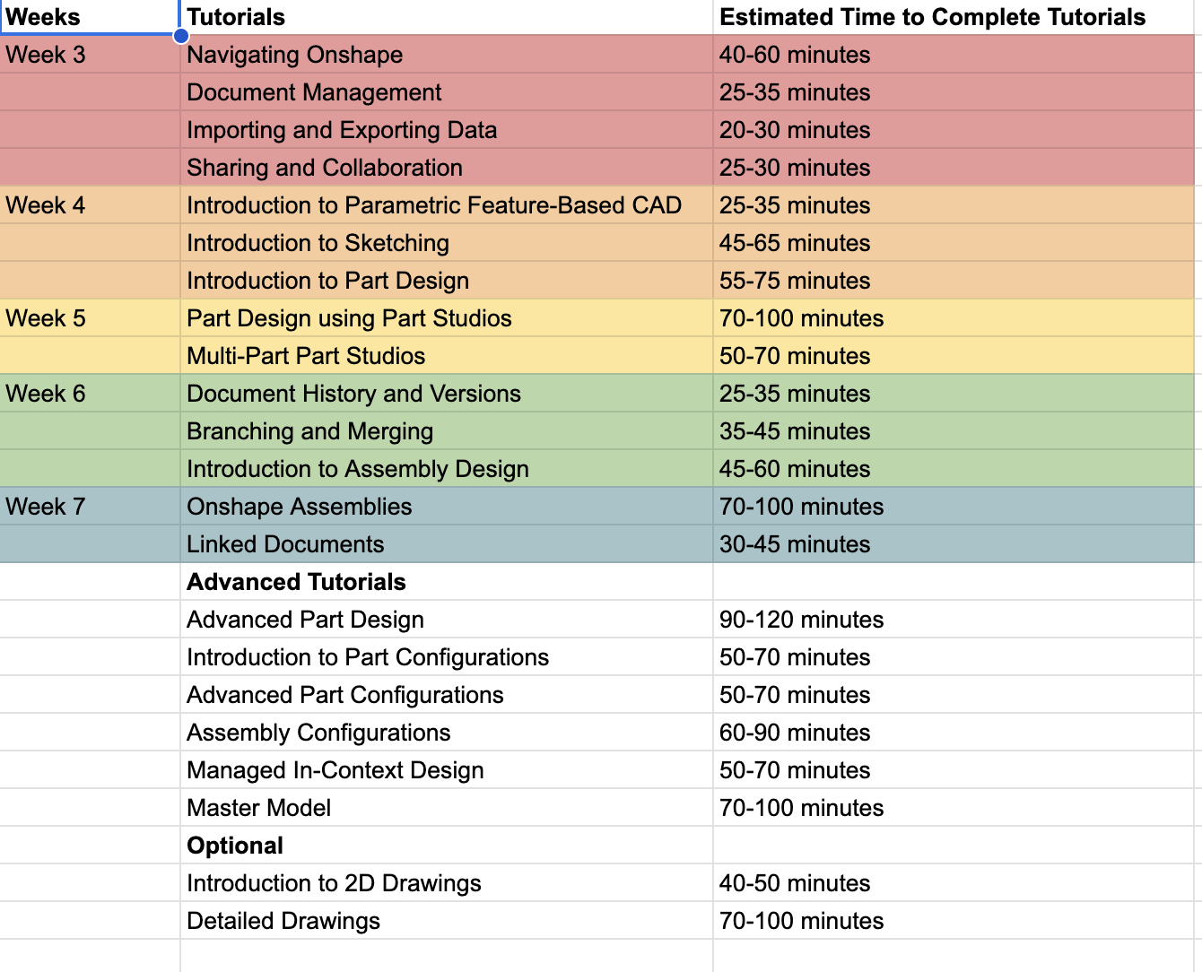
Other Training Materials
Notion
Team generated tutorials and crash courses
Required Learning
Department Task Board
Onshape Tutorials
4 Weeks of Onshape tutorials to learn basics of CAD
Organized in a predetermined manner
Progress is graded
Pre-recorded Workshops and lessons
Ex: Inheritance Machining videos
Notes:
Dhruv
https://www.notion.so/7419techsupport/8337776d6df24988ad2cd5c0e29e4fd1?v=47118af06a194c9fb5913898a50aa8b0

Slide 11
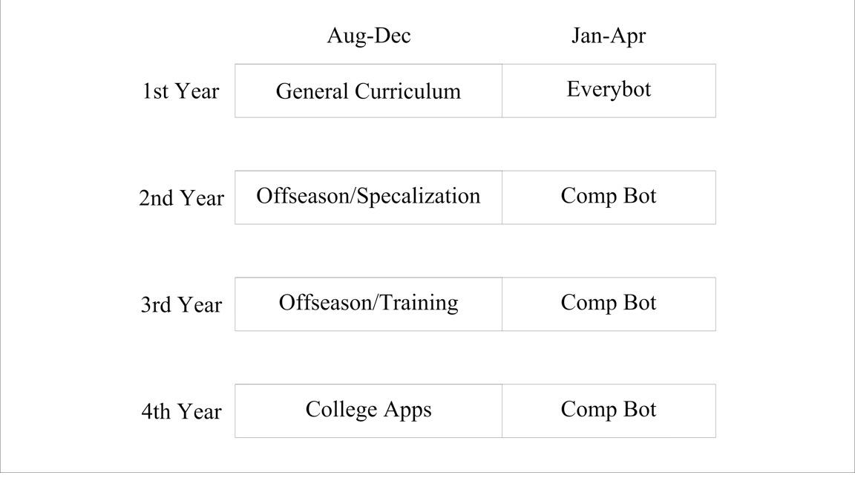
Progression
Notes:
ryab. i can/will cover it quick.

Slide 12
Thanks for Listening!
To contact student leadership: qls7419leadership@gmail.com
To contact mentors:
Leon Cox: lcox@quarrylane.org
Lina Tannous, ltannous@quarrylane.org
Brian Martin, bmartin@quarrylane.org
Website: team7419.tech

